Slide 1

Problem Statement
Attrition is an on-going problem for every company and business. It is more than just a reduction of workforce or re-assigning of responsibilities that are left behind by the exiting employee . Every employee who leaves the company will take with them the much-needed skills and know-how they had acquired during their time spent in the organization. This leads to significant loss to the company; cost of business disruption, hiring and training of new staff.
Employee quits an organization for various reasons. High employee attrition rate will not be good for any company. Thus, the ability to predict if an employee will leave the organization can help to mitigate the attrition problem. This will enable HR to intervene early, review their company approach in job rotation, job transfer, promotion exercise, and many other human resource policies .

Slide 2
Data Exploration And Preparation
The original data set contains 1470 rows and 35 columns. After cleaning and removing the irrelevant columns, the clean data set is left with 1470 rows and 31 column (1 dependent parameter and 30 independent parameters) for further process. Among the 30 features, 23 are numeric and 7 are categorical data.
The dependent parameter (Attrition) has only two states.
There are 1233-“No” and 237-“Yes”. Data set is imbalance.
Some balancing algorithms is need before the classification modelling
Use Histogram to appreciate some of the numeric data such as (Age, Monthly Income, etc.)
Use GroupBy and Bar Chart to understand the effect of each category on the attrition
Further investigation into the data set, shows some columns are similar and duplicate in nature. These columns can be deleted before one-hot encoding is performed.
Convert the Attrition(Yes, No), Gender(Male, Female) and OverTime(Yes, No) columns from String type to Numeric type (1 and 0) to reduce OHE activities.

Slide 3
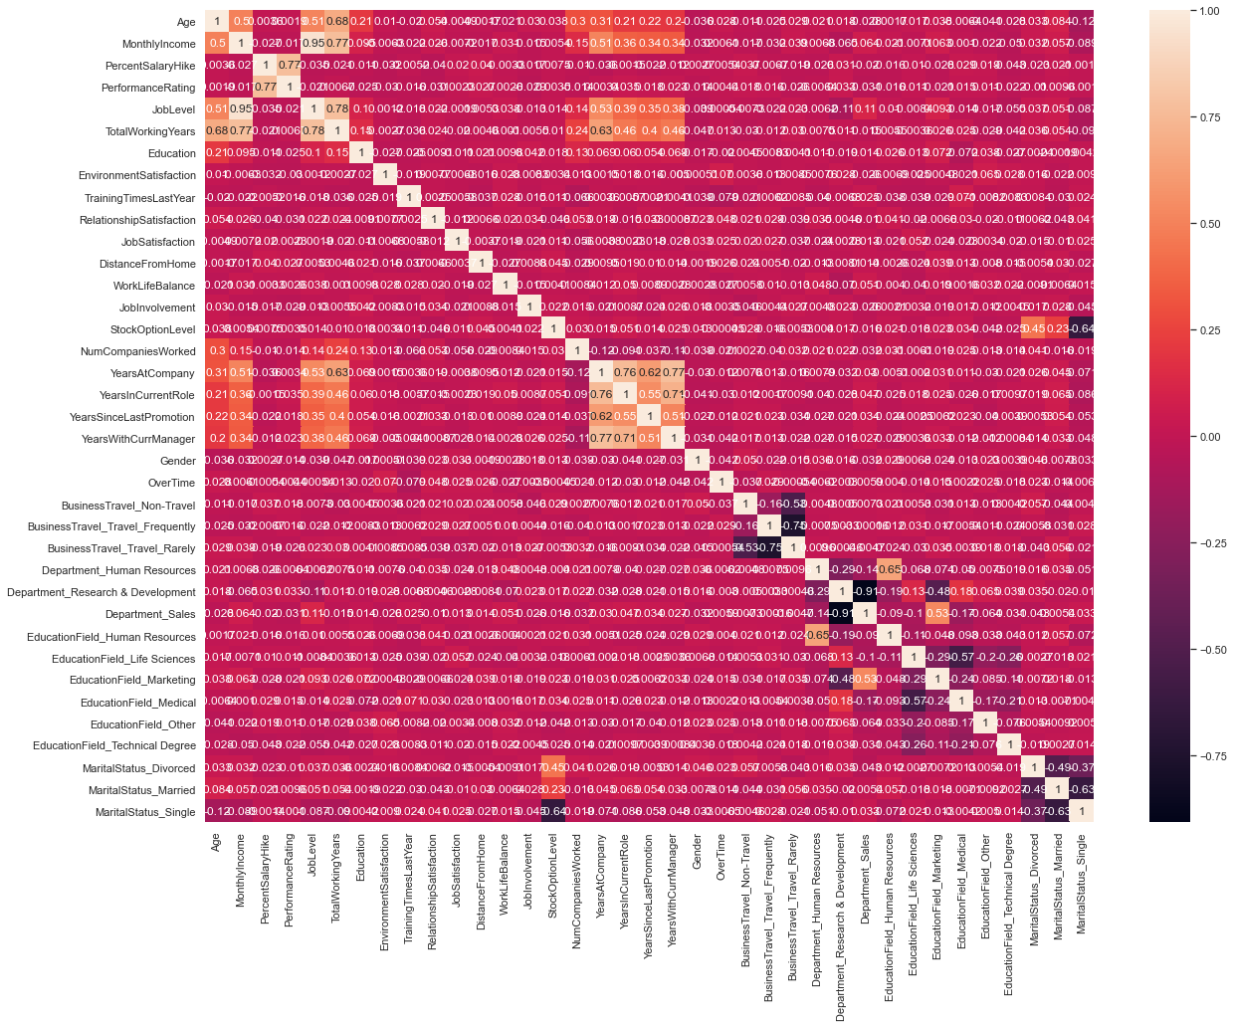
Feature Engineering (One-Hot Encoding)
Performed one-hot encoding (OHE) on the categorical data.
Remove the target column [Attrition] from the OHE feature set.
The final number of features before performing PCA is 37 (features_with_OHE)
Correlation matrix indicates some strongly correlated features as shown by the colour code

Slide 4
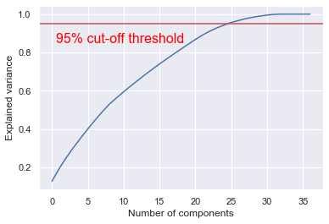
Feature Engineering (PCA)
Apply z-score standardization, to normalize the data. StandardScaler() is used.
scaler = StandardScaler()
scaled_features = scaler.fit_transform( features_with_OHE)
Obtain the one-dimensional numpy cumulative-sum array explained_variance_ratio for the 37 PCA components.
On the right shows the plot for explained_variance_ratio vs number of components.
At 95% cut-off threshold, there is a dimensionality reduction from 37 to 25.

Slide 5
Classification Models
The dependent parameter is imbalance (1233-No, 237-Yes). Performed SMOTE on the PCA dataset (25 components and target parameter [Attrition]) to handle the imbalanced data.
Due to the small number of data set (only 1470 rows), more data is allocated for training. The ratio use in splitting the training and test set is at 80 : 20 instead of 70:30.
At initial stage of modelling, standard parameter is used for the various classification model below.
- Support Vector Machine() - SVM
- Gradient Boosting Classifier() - GBC
- Random Forest Classifier() - RFC
- Decision Tree Classifier() - CART
- Linear Discriminant Analysis() - LDA
- Logistic Regression() - LR
From the initial run, it was found that the top 3 models for accuracy and recall values are:
Support Vector Machine, Gradient Boosting Classifier and Random Forest Classifier.
In this presentation the focus will be on Support Vector Machine and Random Forest Classifier.

Slide 6
Hyper-Parameters Tuning
Grid Search is performed for the Support Vector Machine and Random Forest Classifier models.
Run the grid search on only the training data.
After some computationally intensive run, the followings hyper-parameter values from the grid search are generated.
# Support Vector Machine (SVM)
# hyper-parameter after 2880 fits
gamma = 'auto',
kernel = 'poly',
degree = 5,
cache_size = 200,
shrinking = True,
class_weight = None,
decision_function_shape = 'ovr',
# Random Forest Classifier
# hyper-parameter after 1080 fits
n_estimators = 1000,
Criterion = "entropy",
max_depth = None,
min_samples_leaf = 3,
max_features = 0.3
Training Set Mean Absolute Error: 0.0137 Test Set Mean Absolute Error: 0.0648
Training Set Mean Absolute Error: 0.0000 Test Set Mean Absolute Error: 0.0850

Slide 7
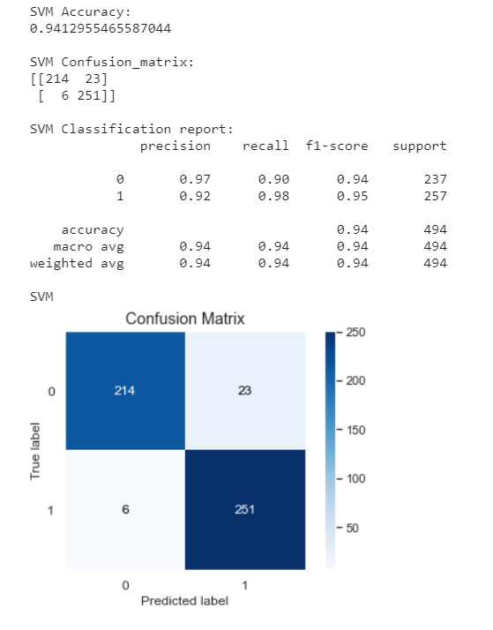
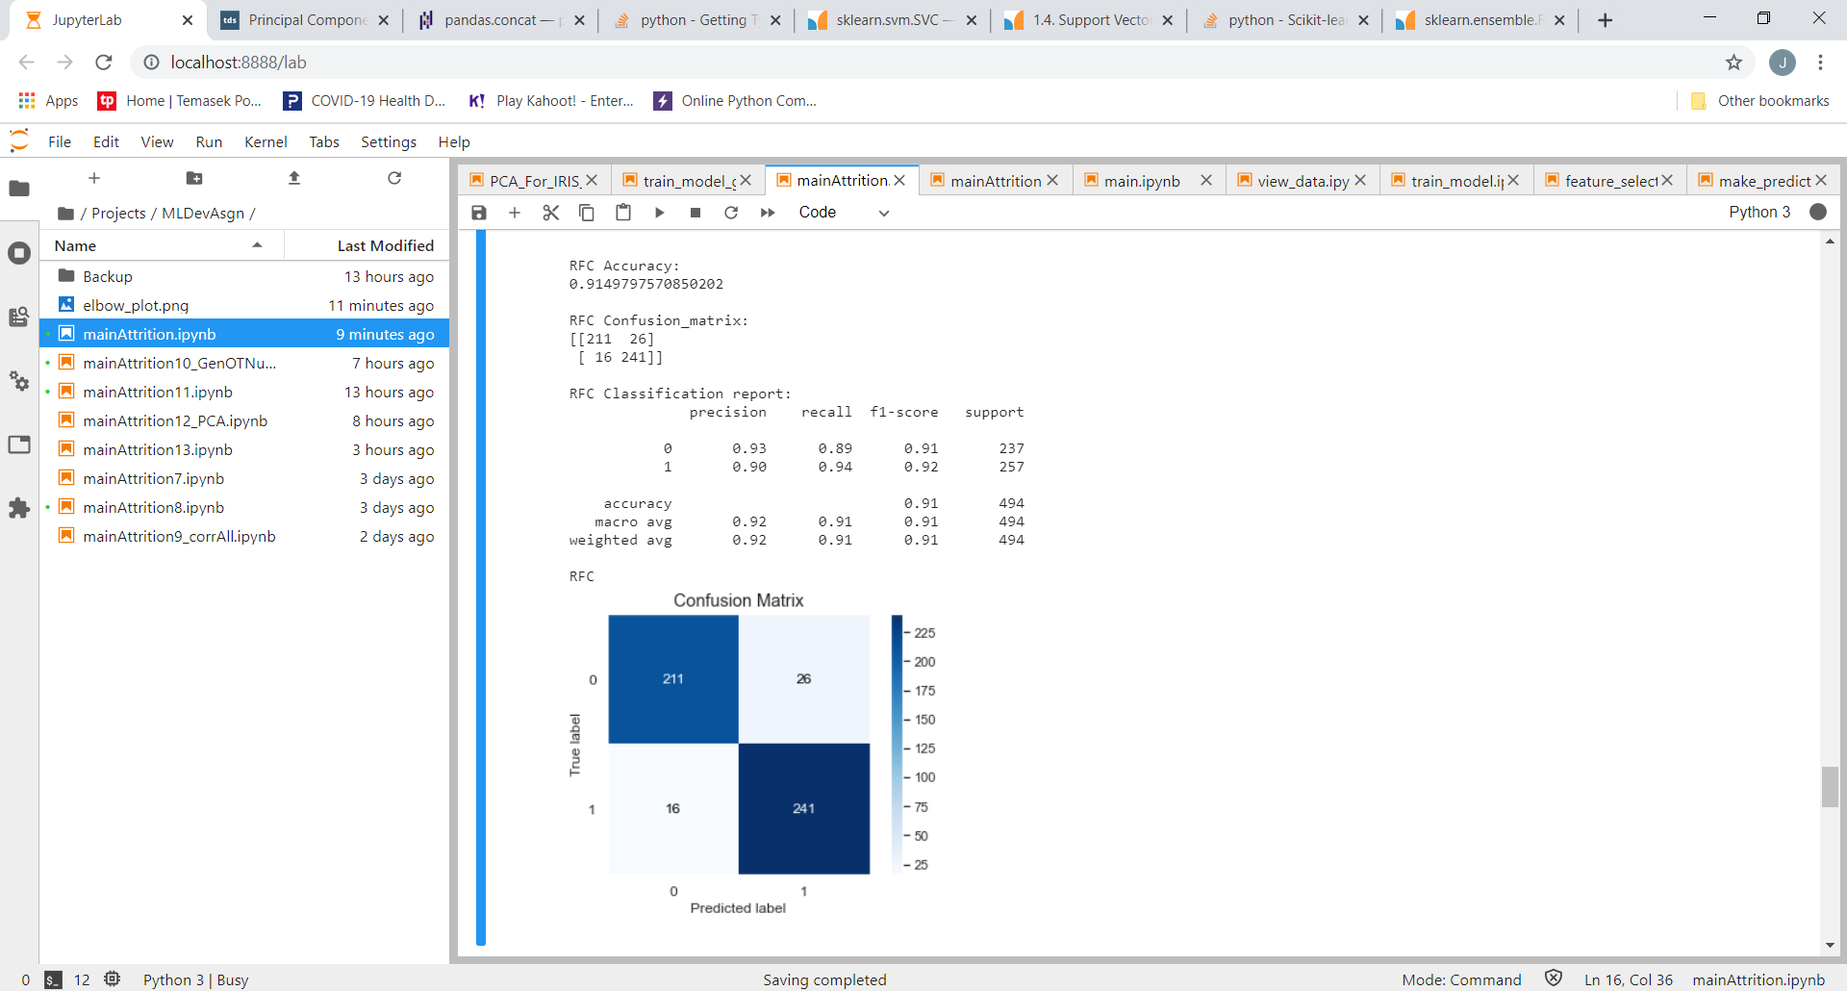
Results and Analysis
Support Vector Machine Results
Accuracy : 94% Recall: 98%
Random Forest Classifier Results
Accuracy : 91% Recall: 94%

Slide 8

Conclusion
In this attrition data set, it is important that Type II Error (False Negative) is kept as low as possible. Therefore, besides having a high accuracy, the model must also be able to achieve a high recall value.
From the results generated, Support Vector Machine (SVM) is the most desirable. Both the recall and accuracy value are the highest (98% and 94% respectively) among the various classification models generated.
Note :
In this presentation, normalization of data is done before PCA.
For decision purpose, normalization can also be done after splitting the test and training test set. This is to ensure that the test data is not effected by the normalized training set (data leakage).
- De-normalize the PCA data set
- Perform SMOTE to handle the imbalance data set
- Split the test and training data set
- Normalize the training data set only
- Generate the model with the normalize training data set
- Normalize the test data set
- Validate and prediction using the normalize test data

Slide 9
Attrition Data Set : https://www.kaggle.com/pavansubhasht/ibm-hr-analytics-attrition-dataset
Random Forest Classifier : https://scikit-learn.org/stable/modules/generated/sklearn.ensemble.RandomForestClassifier.html
Support Vector Machine : https://scikit-learn.org/stable/modules/generated/sklearn.svm.SVC.html
Principal Component Analysis : https://towardsdatascience.com/principal-component-analysis-pca-with-scikit-learn-1e84a0c731b0
Grid Search : https://scikit-learn.org/stable/modules/generated/sklearn.model_selection.GridSearchCV.html
References

